Slide 1

Analysis of Wine Data

Slide 2
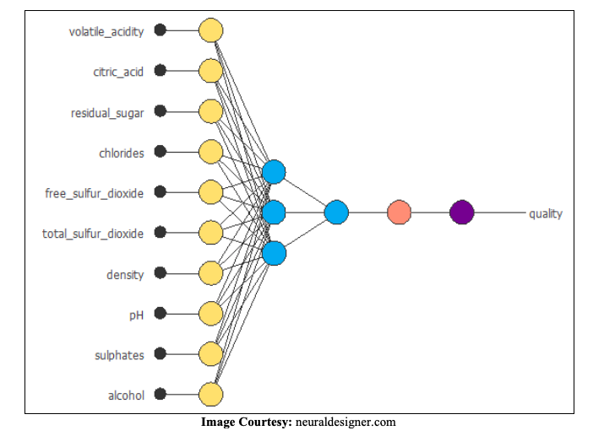
Features of the Data –
Predictors –
Fixed acidity
Volatile acidity
Citric acid
Residual sugar
Chlorides
Free sulfur dioxide
Total sulfur dioxide
Density
pH
Sulphates
Alcohol
Response –
Quality

Slide 3
Objective
In this project our intention is to gain maximum knowledge about this data by performing EDA and to check the goodness of a fitted logistic regression model.

Slide 4
Analysis
Checking for missing observations
Analysis of the Response
Analysis of the Predictors
Correlation among the Predictors

Slide 5
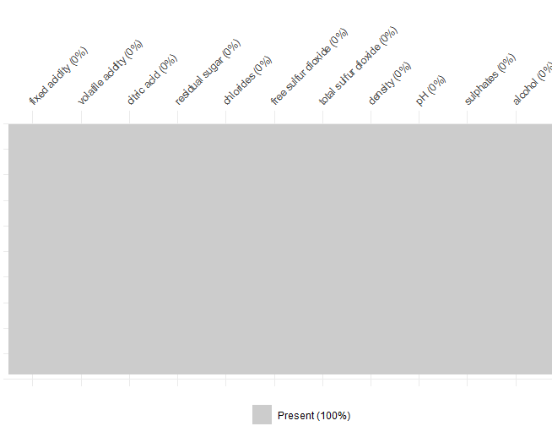
Checking for missing values
There is no missing observations present in the data

Slide 6
Analysis of the response variable

Slide 7
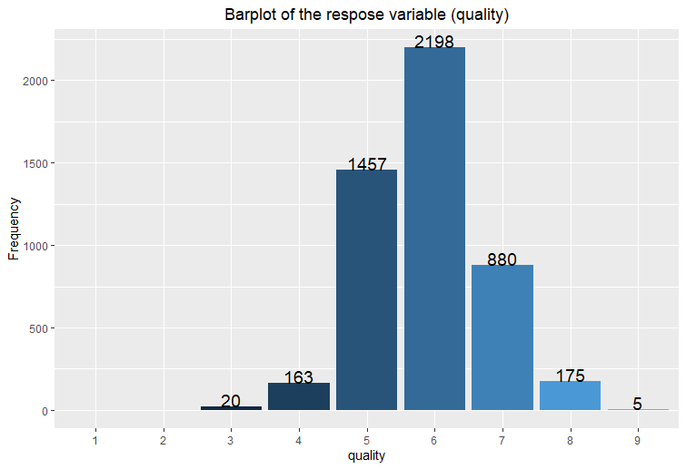
Distribution of Quality

Slide 8
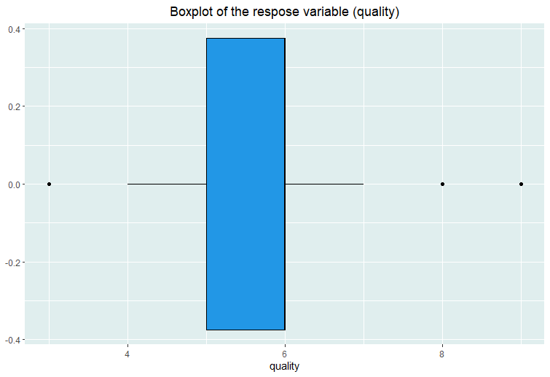
Boxplot of Quality

Slide 9
Analysis of the Predictors

Slide 10
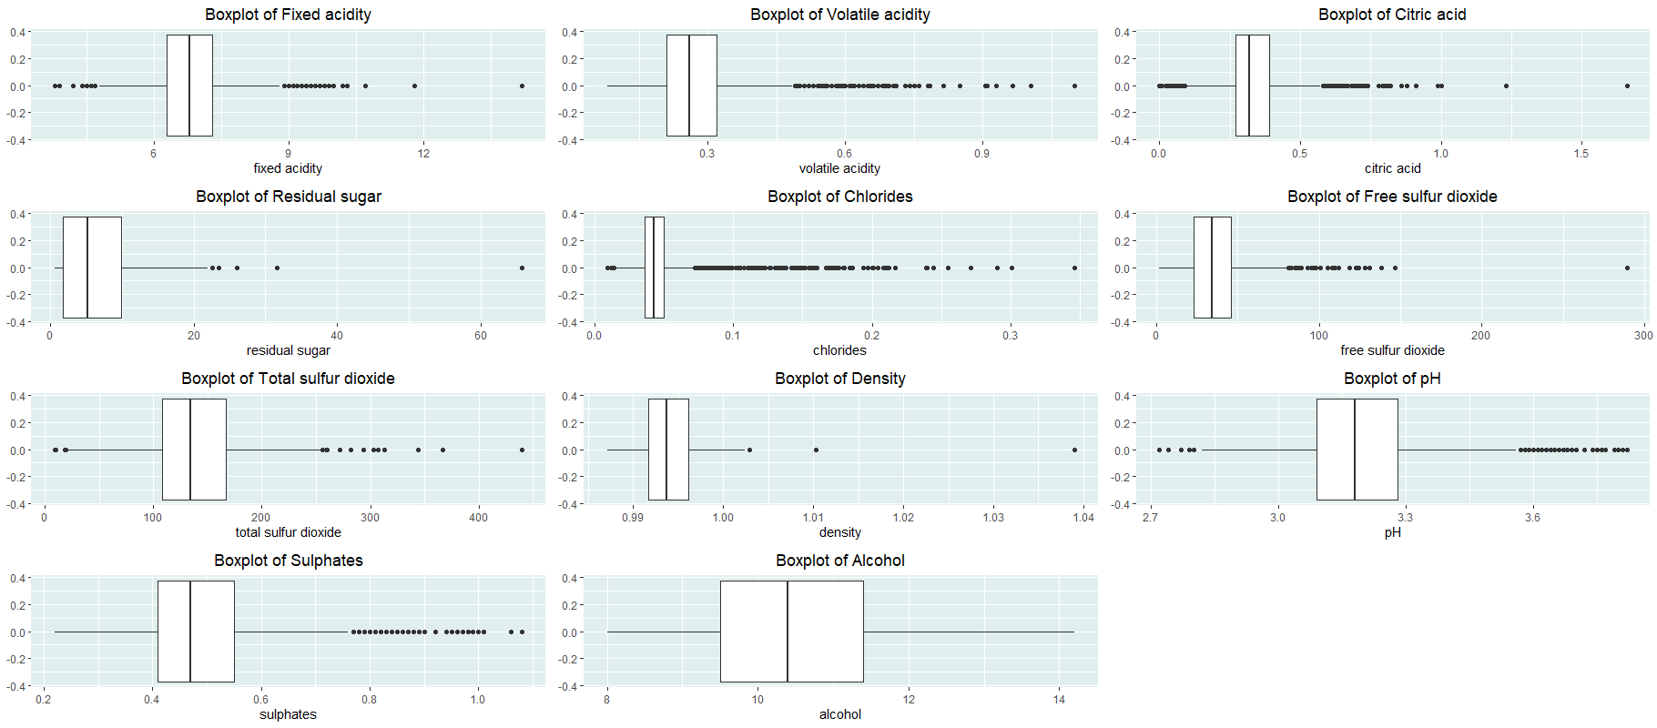
Boxplot of the predictors

Slide 11
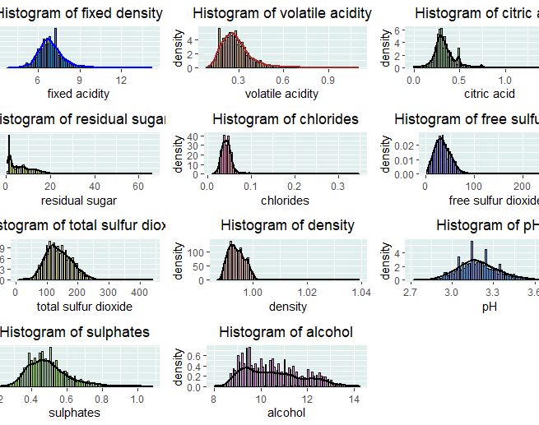
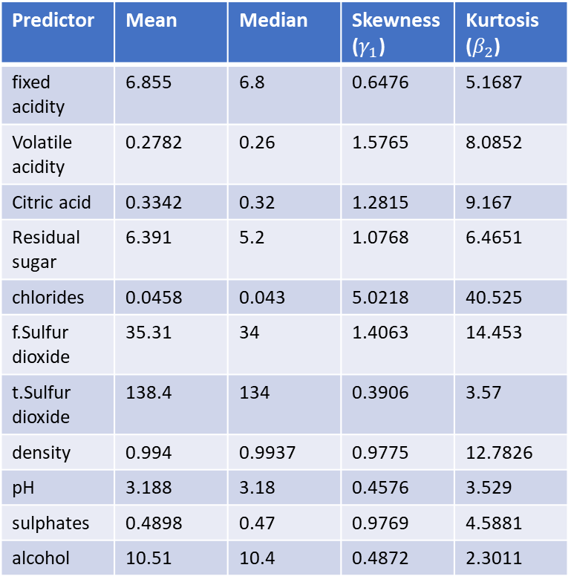
Distribution of the Predictors
Predictor | Mean | Median | Skewness($γ_{1}$) | Kurtosis ($β_{2}$)
fixed acidity | 6.855 | 6.8 | 0.6476 | 5.1687
Volatile acidity | 0.2782 | 0.26 | 1.5765 | 8.0852
Citric acid | 0.3342 | 0.32 | 1.2815 | 9.167
Residual sugar | 6.391 | 5.2 | 1.0768 | 6.4651
chlorides | 0.0458 | 0.043 | 5.0218 | 40.525
f.Sulfur dioxide | 35.31 | 34 | 1.4063 | 14.453
t.Sulfur dioxide | 138.4 | 134 | 0.3906 | 3.57
density | 0.994 | 0.9937 | 0.9775 | 12.7826
pH | 3.188 | 3.18 | 0.4576 | 3.529
sulphates | 0.4898 | 0.47 | 0.9769 | 4.5881
alcohol | 10.51 | 10.4 | 0.4872 | 2.3011

Slide 12
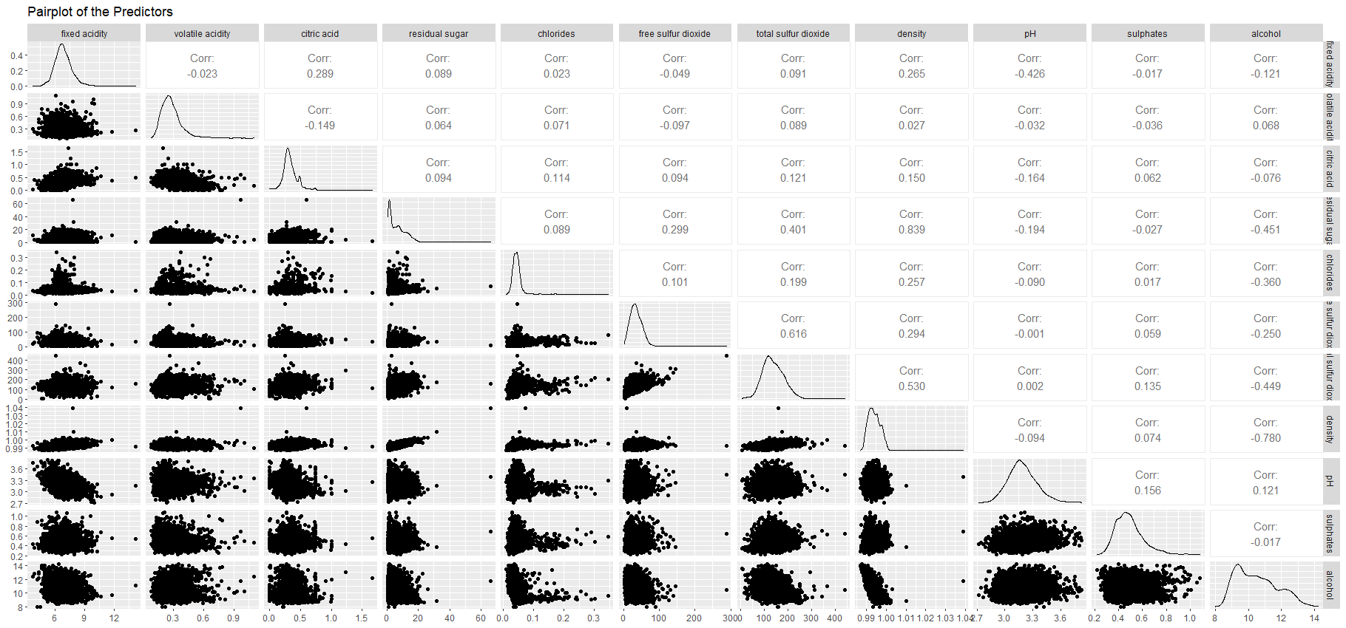
Correlation among the Predictors

Slide 13
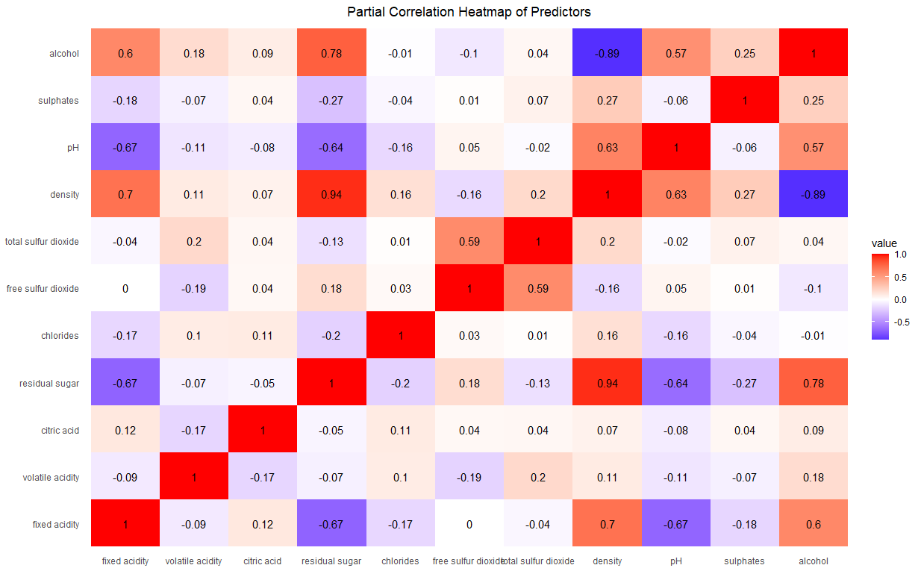

Slide 14
Building a Regression Model
This part of our work includes –
Step-1
Transforming our response into a binary variable (‘good’ quality and ‘bad’ quality)
Step-2
Fitting a Binomial Logistic Regression model to this data
Step-3
To check the goodness of the fit

Slide 15
Results -
Term | Estimate | Standard error | Statistic | P-value | Significance
intercept | 258.2369 | 70.986 | 3.638 | 0.0003 | ***
Fixed acidity | 0.0365 | 0.072 | 0.508 | 0.6113
Volatile acidity | -6.4580 | 0.413 | -15.646 | 3.53x10^(-55) | ***
Citric acid | 0.1158 | 0.303 | 0.382 | 0.7022
Residual sugar | 0.1701 | 0.027 | 6.291 | 3.16x10^(-10) | ***
chlorides | 0.8852 | 1.671 | 0.520 | 0.5964
Free sulfur dioxide | 0.0096 | 0.003 | 3.451 | 0.0006 | ***
Total sulfur dioxide | -0.0013 | 0.001 | -1.101 | 0.2710
density | -270.874 | 71.952 | -3.765 | 0.0002 | ***
pH | 1.0890 | 0.362 | 3.013 | 0.0026 | **
sulphates | 1.7974 | 0.350 | 4.990 | 5.75x10^(-7) | ***
alcohol | 0.7420 | 0.094 | 7.937 | 2.05x10^(-15) | ***
Null deviance – 6245.4 on 4897 degrees of freedom
Residual deviance – 4932.6 on 4886 degrees of freedom

Slide 16
Goodness of Fit -
To test,
H₀ : The model is correctly specified
against
H₁ : The model is not correctly specified
Test statistic – D = 2(l_{max} - l) ,where, l is the log-likelihood of the model of interest and l_{max} is that of the saturated
model
Under H₀, D ~ χ²₄₈₈₆
We reject H₀ if and only if D_{obs} > χ²_{0.05:4886} (0.05 is the chosen level of significance)
D_{obs} = 4932.6
χ²_{0.05:4886} = 5049.73
Conclusion –
In the light of the given data it seems that the model is correctly specified.

Slide 17
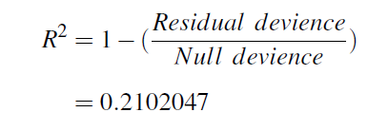
Moreover, we can compute the pseudo R² as
Therefore, only 21.02 % of the total variability in ‘quality’ can be explained by the fitted model.

Slide 18
Acknowledgement
I would like to express my special thanks to my project supervisor Professor Ayan Chandra. He constantly supported me and guided me with his valuable advice whenever I was stuck with my work.
Also, I would like to thank my family and my friends. They helped me with the relevant knowledge they had and kept me motivated to work constantly on my project. My work was made easier by them.

Slide 19
THANK YOU

